Slide 1
Healthy Food Accessibility Across Indiana
Kaitlyn Christian

Slide 2
The Problem
Younger generations have increasing concerns surrounding food and the environment.
These concerns have led to increased popularity in plant-based diets, specifically with Gen Z (9 – 24) and Millennials (25 – 40).
Accessibility of plant-based options has not yet caught up to the growing demand.
Indiana has a total population of over 6.7 million individuals, and an average age of 37.4.
There is a need for more accessible plant-based options in Indiana.

Slide 3
Data
Geographic data was pulled from Wikipedia to determine cities in Indiana.
Population counts and demographics were obtained from the United States Census Bureau.
Restaurant data across Indiana was gathered from HappyCow, an online resources dedicated to making healthier food options more accessible.
The data were cleaned and analyzed using Python 3.8.

Slide 4
Methodology
Web scraping was utilized for the Wikipedia page to gather a full list of cities in Indiana.
The data were cleaned and unnecessary rows were removed.
Restaurant data from HappyCow was used to remove any cities that already have vegan and/or vegetarian restaurants and cities that had restaurants with vegan or vegetarian options.
To impact the greatest number of individuals, and help aid sustainability of a new restaurant, cities with a population less than 20,000 were removed.
Cities with an average age over 40 were also to be removed, though none of the remaining cities had a average age above 40.

Slide 5
Results
Seven cities emerged from the analysis as opportunity locations for a new plant-based restaurant.
Each of the cities have a population over 20,000 and they currently do not have any restaurants solely dedicated to vegans or vegetarians, nor do they have any restaurants that offer vegan or vegetarian options.
The cities are Brighton, East Chicago, Hobart, Jeffersonville, Portage, Seymour, and Shelbyville.
Additionally, each of these cities have a median age that falls within the target generational group. According to the United States Census Bureau, the median age for Brighton is 37.5, East Chicago is 33.8, Hobart is 38.2, Jeffersonville is 37.9, Portage is 38.4, Seymour is 36.4, and Shelbyville is 36.2.

Slide 6
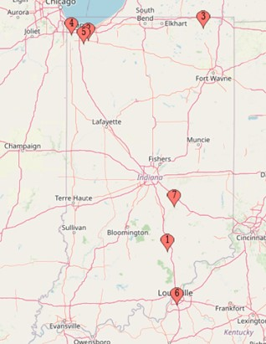
Results
The map to the right shows the location of each city. . The majority of the cities are evenly dispersed across the state, which is a positive opportunity for greater access to healthier options for differing regions.

Slide 7
Discussion
The results of this analysis identified seven cities across Indiana. The cities were located in the North East, North West, Central, and Southern regions of Indiana, offering a rather comprehensive distribution.
The cities selected are not only regionally diverse, but they also each demonstrate a need for plant-based options. The population size and median age of each city are both factors that are reasonably assumed to increase the viability of a successful plant-based restaurant.
The primary purpose of this analysis was to identify which cities in Indiana had a need for a plant-based restaurant. The next recommended step, outside the scope of this analysis, is to engage with the residents of each city through a series of town halls, focus groups, and surveys to better understand if there is a desire for plant-based options.

Slide 8
Conclusion
This analysis identified seven cities across Indiana that would be viable locations for a plant-based restaurant, as determined by current restaurant availability and population demographics.
Three of these seven cities are close in proximity and could potentially share one centrally located restaurant. If one restaurant was centrally placed between those three cities, it would result in a total of five new plant-based restaurants in Indiana.
Increasing accessibility to healthier options is a benefit to the residents of these cities, and the state as a whole. Healthier diets result in a domino effect of positive outcomes for individual health, healthcare resources, and the environment. Greater accessibility to healthier food options is becoming increasingly necessary across the United States for both the health of its citizens and the environment it inhabits.

